Slide 1
Automation of French Conversion task Of an existing CMM Using Python and AI

Slide 2
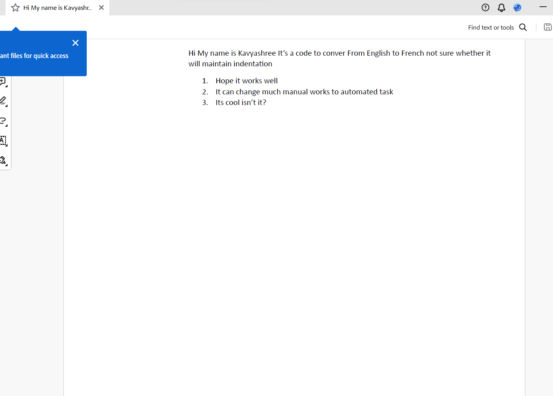
Placing the English Cmm in a particular Path

Slide 3
Backend works( Python Code)
Objective: Translate text from an English PDF document to French and save the translated text in a new PDF file.
Libraries Used:
transformers: Used for loading pre-trained translation model and tokenizer.
fitz: Used for extracting text from PDF documents.
tensorflow: Used for tensor operations.
fpdf: Used for creating and saving PDF files.

Slide 4
Code Overview
Load pre-trained English to French translation model and tokenizer.
Define functions to read text from a PDF, translate text from English to French, and save translated text to a new PDF.
Read text from the English PDF document.
Translate the English text to French using the pre-trained model.
Save the translated French text to a new PDF file.
Future Enhancements:

Slide 5
Challenges and Future Enhancements:
Ensuring proper installation and compatibility of required libraries.
Handling encoding and decoding issues when working with text and PDF files.
Implement error handling for robustness.
Explore other translation models for improved accuracy.
Enhance the user interface for better usability.

Slide 6
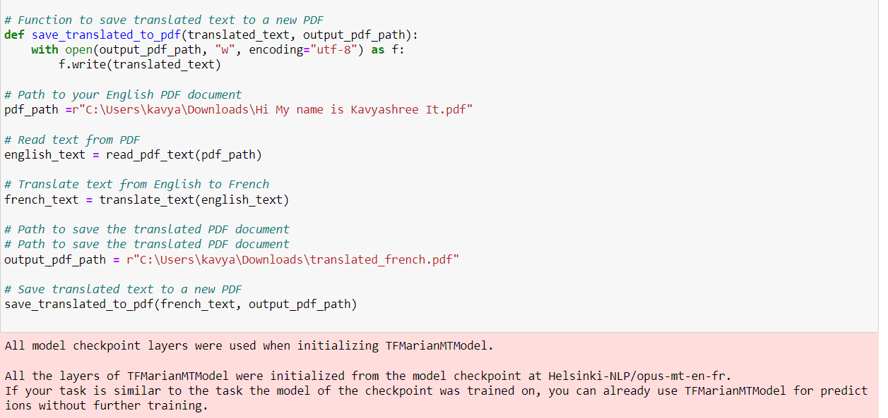
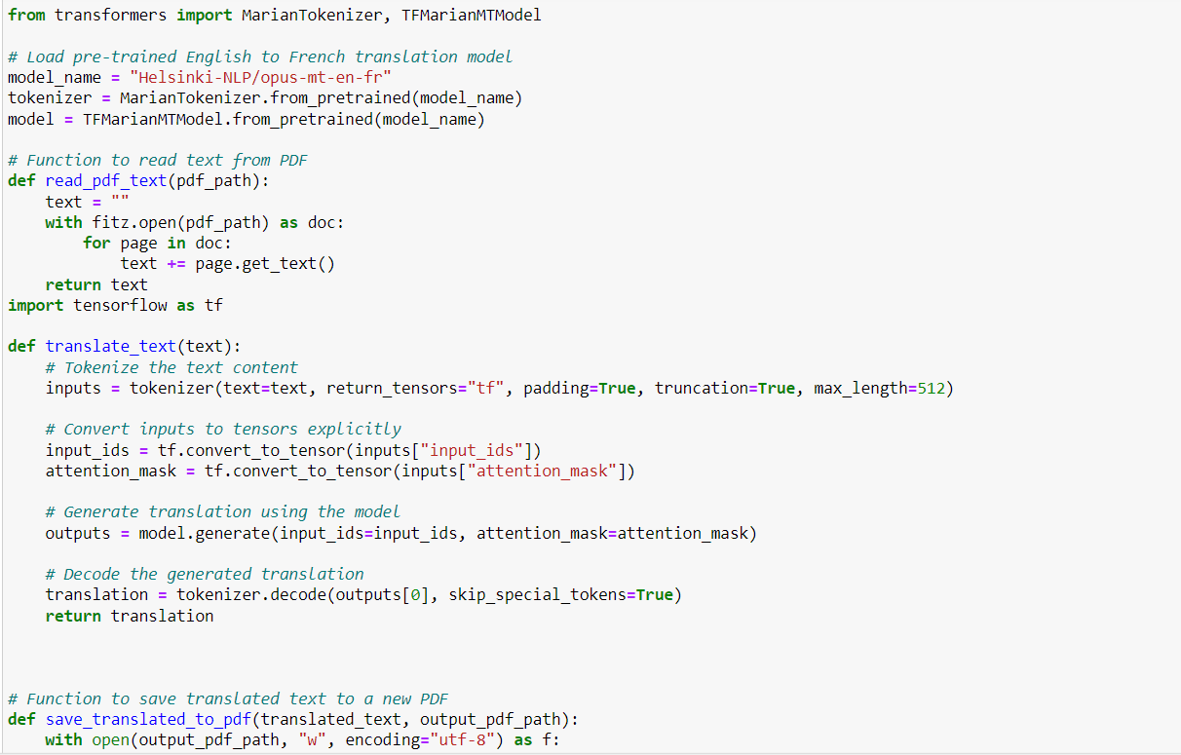
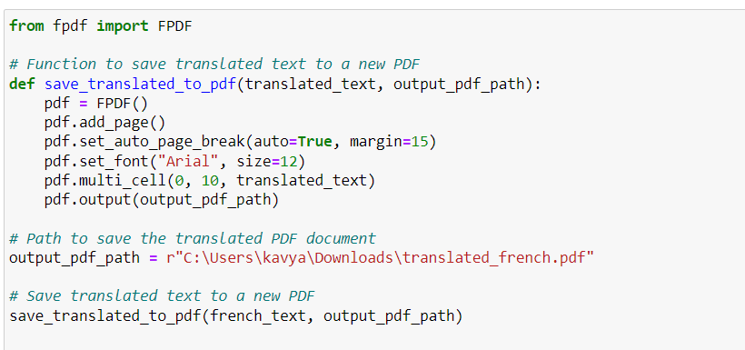
Written Code

Slide 7
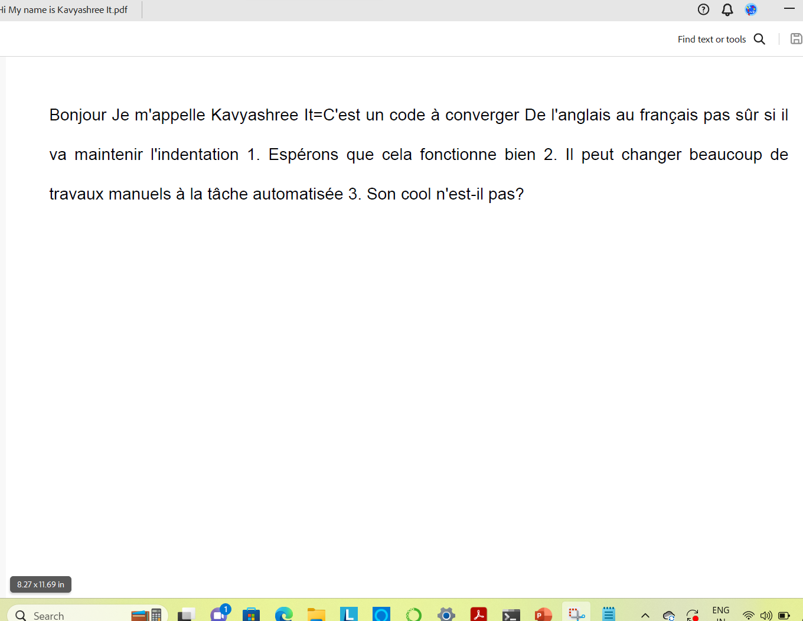
Output

